Slide 1
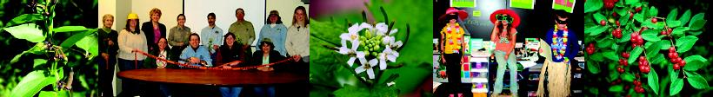

Introduction to Cooperative Weed Management Areas
What are they, what can they do for me, and how do I get one started?
Kate Howe
Midwest Invasive Plant Network
Purdue University

Slide 2

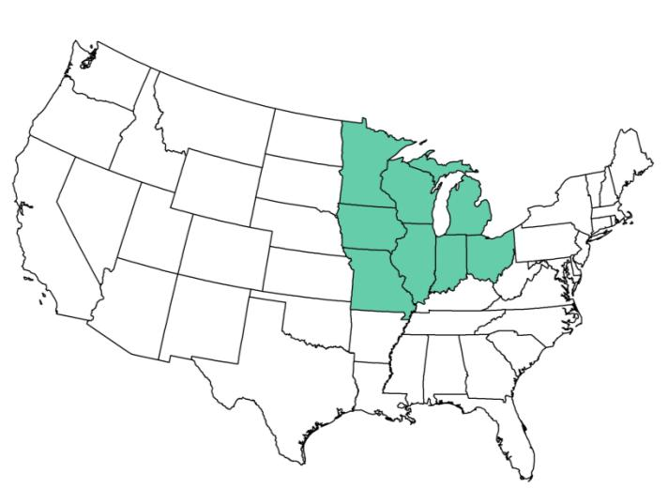
The mission of the Midwest Invasive Plant Network is the reduce the impact of invasive plants in the Midwest.

Slide 3
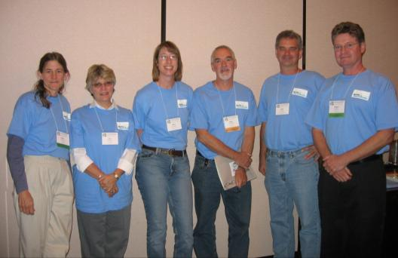

What does MIPN do?
Facilitates collaboration and information exchange among organizations
Works to improve prevention, early detection, education, and research on invasive plants at a regional level

Slide 4
Overview
What is a Cooperative Weed Management Area?
Why form a CWMA?
CWMAs in the West
The development of CWMAs in the East
How to organize a CWMA
Other resources

Slide 5
What is a CWMA?
Cooperative Weed Management Areas (CWMAs) are local organizations that facilitate collaboration across jurisdictional boundaries for more effective invasive plant management.

Slide 6
6 basic characteristics of a CWMA
Operate within a defined, local geographic area
Involve a broad cross-section of landowners and natural resource managers
Led by a steering committee
Long-term commitment to cooperation (e.g. MOU)
Have a comprehensive plan for invasive plant management
Facilitate cooperation across jurisdictional boundaries

Slide 7
There is no official certification of CWMAs.
Having all 6 characteristics of a CWMA:
helps ensure the long-term viability of your organization
demonstrates commitment to potential funders

Slide 8
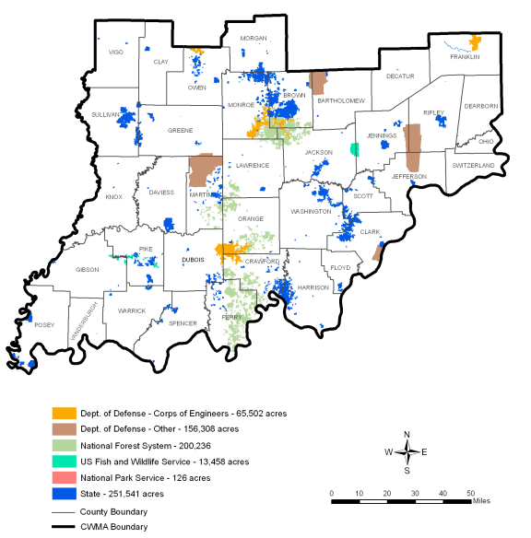
Benefits of a CWMA
They cross boundaries

Slide 9
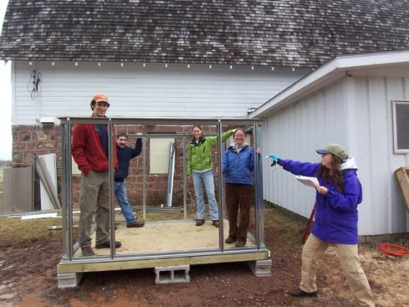
Benefits of a CWMA
They allow partners to share and leverage limited resources.

Slide 10
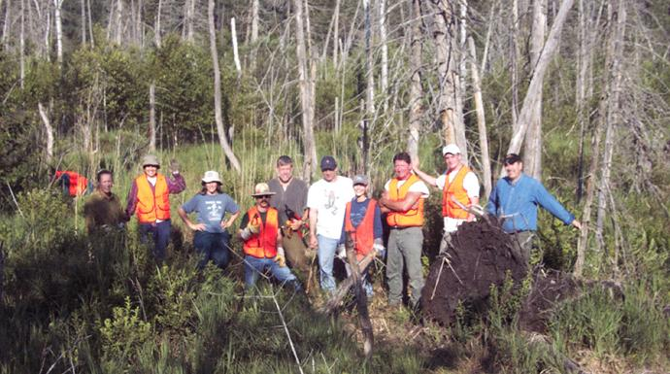
Benefits of a CWMA
CWMAs are highly visible.

Slide 11
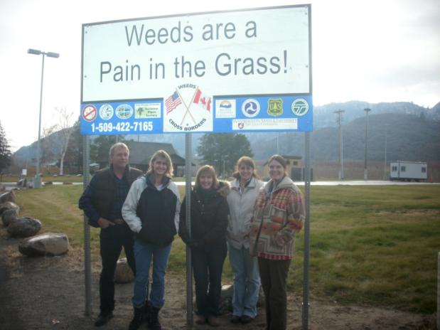
Benefits of a CWMA
They raise awareness of invasive species.

Slide 12
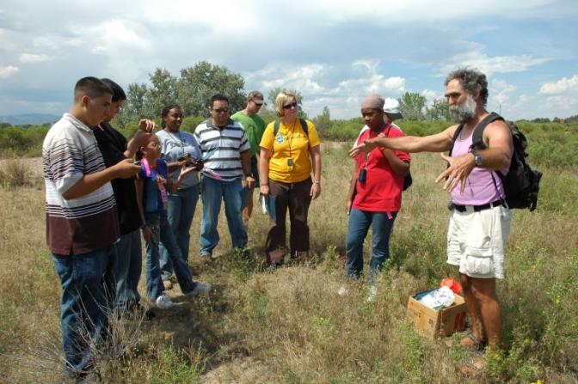
Benefits of a CWMA
They provide an early detection and rapid response network.

Slide 13
Benefits of a CWMA
They can help secure funding for invasive plant projects.
Examples:
National Fish &Wildlife Foundation, Pulling Together Initiative
USFS State & Private Forestry
USFWS
State funds
Private foundations

Slide 14
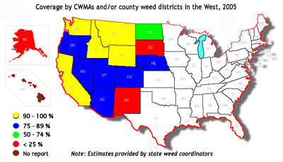
Cooperative Weed Management Areas in the West

Slide 15
Highlights of Accomplishments for California Weed Management Areas, 2001-2004
• The eradication of 2,015 populations of high priority weed infestations;
• The treatment of more than 128,421 acres of high priority weed infestations;
• The receipt of $7,025,187 in matching funds from outside grant funding and the contribution of in-kind donations and services by WMAs valuing $9,109,946;
• The distribution of $5.6 million to 45 WMAs covering 57 counties;
• The development of new local partnerships between public agencies, private landowners, agriculturalists and conservationists, with outreach programs reaching 88,803 people; and
• Attendance by 6,781 people at regular weed management meetings throughout the state.

Slide 16
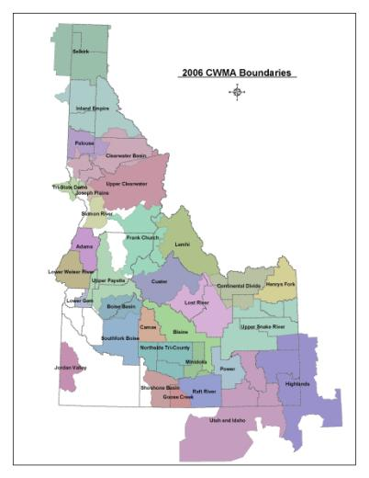
Our goal is to increase coverage by CWMAs in the East.

Slide 17
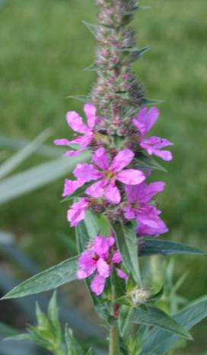
Examples of CWMAs in the East
Long Island Invasive Species Management Area (NY)
Northwoods CWMA (WI)

Slide 18
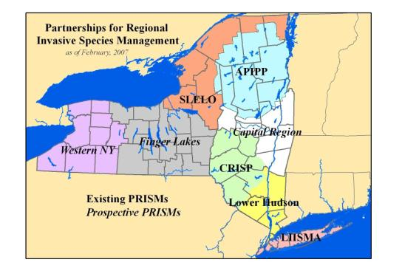
CWMAs in the East Long Island Invasive Species Management Area (LISMA)
Formed in 2001
Along with Adirondack Park Invasive Plant Program, has served as a model for the development of 6 additional Partnerships for Regional Invasive Species Management (PRISMs) in New York

Slide 19
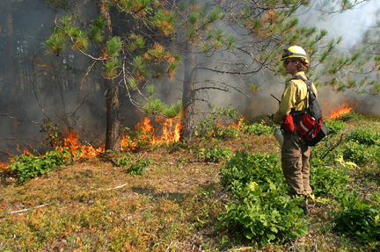
LISMA Accomplishments
Year 1:
Wrote a strategic plan
Prepared and categorized a list of invasive plant species
Started Weed Watchers program

Slide 20
LISMA Accomplishments
Year 2:
Assisted in drafting legislation for Invasive Species Task Force for NY
Mapped weeds in 800-acre Pine Barrens Core Preserve
NYS Landscape and Nursery Association adopted
St. Louis Codes of Conduct
Wipe out Weeds poster contest in elementary schools
Early Detection/Rapid Response carried out on sites of
giant hogweed, black swallow-wort, mile-a-minute vine, and others
Researched herbicides for use against black swallow-wort

Slide 21
LISMA Partners
National Park Service
U.S. Fish and Wildlife Service
Brookhaven National Laboratory
Natural Resource Conservation Service
NY State Department of Transportation
NY Department of Environmental Conservation
NY Office of Parks, Recreation, & Historic Preservation
City of New York Parks & Recreation
Cornell Cooperative Extension of Suffolk County
Suffolk County Dept. of Parks, Recreation, and Conservation
Nassau County Department of Parks, Recreation, and Museums
Suffolk County Community College
Theodore Roosevelt Sanctuary and Audubon Center
Long Island Nursery and Landscape Association
Long Island Central Pine Barrens Commission
Open Space Preservation Trust
Brooklyn Botanic Garden
The Nature Conservancy

Slide 22
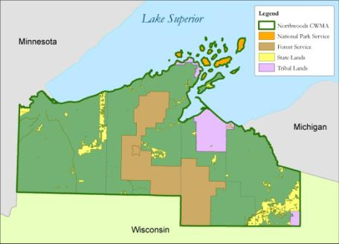

CWMAs in the East Northwoods CWMA (WI)
Started as the Northwoods Weed Initiative, working on a grant for leafy spurge control
Formed a CWMA to formalize the partnership and work on more projects
Located in Ashland, Bayfield, Douglas, and Iron Counties in far northern WI

Slide 23
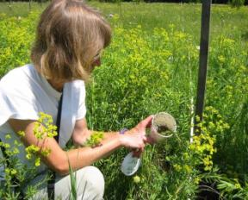
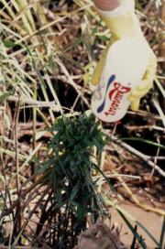
Northwoods CWMA (WI)
Primary Objectives:
To prevent new invaders from taking hold in the area
To control new invasive species
To contain and manage existing populations that have already become established

Slide 24
Northwoods CWMA (WI)
Partners
Great Lakes Indian Fish and Wildlife Commission
Chequamegon/Nicolet National Forest
National Park Service
Natural Resource Conservation Service
Ashland, Bayfield, Douglas Co. Land Cons. District
The Nature Conservancy
US Fish and Wildlife Service
University of Wisconsin Extension
Wisconsin DNR
Bad River Chippewa Band

Slide 25
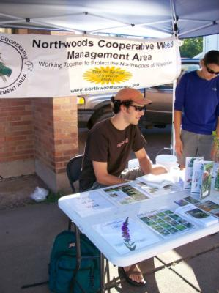
Accomplishments
Prevention:
-Scheduled roadside mowing activities to prevent spread of leafy spurge
Mapping and monitoring:
Inventoried and mapped local invasive plant populations
Education:
Developed “Homeowner’s Guide to Japanese Knotweed Control”
Taught public seminars on treatment of buckthorn and honeysuckle
-Developed curriculum for K-12 classes on invasive plants
-Created PowerPoint presentations to educate local policy makers about invasive plant issues
Control and management:
- Cooperative control efforts for Japanese knotweed, buckthorn, spotted knapweed, purple loosestrife, and other species
www.NorthwoodsCWMA.org

Slide 26
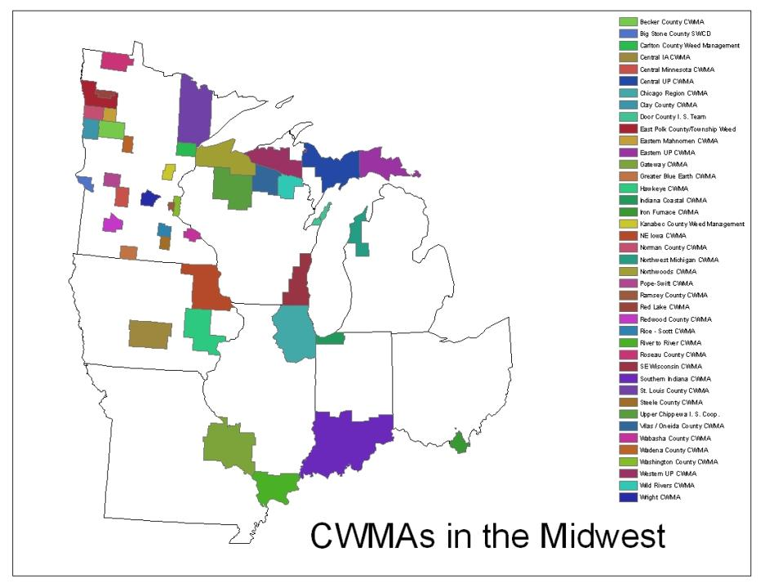
Fall 2008

Slide 27
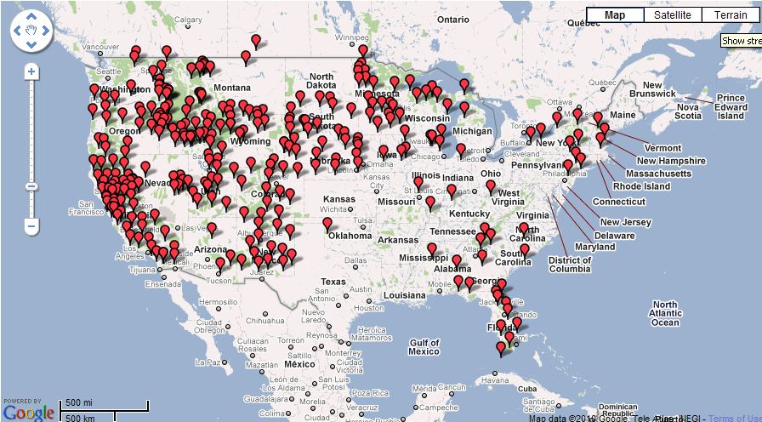
National CWMA map
www.invasiveplantcenters.org

Slide 28
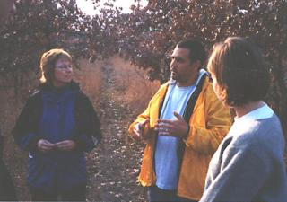
Organizing a CWMA
Identify a leader or champion
Find someone who is excited about cooperative weed management to lead the group as it forms
Good communicator
Ability to motivate others
Goals of the CWMA must be their first priority
The CWMA champion may be a short-term role, leading only until the steering committee is in place.

Slide 29
Organizing a CWMA
Establish geographic boundaries
Political boundaries, e.g. one or several counties
Ecological boundaries, e.g. watersheds
Consider organizing a large CWMA into smaller subunits such as basins, watersheds, or management zones

Slide 30
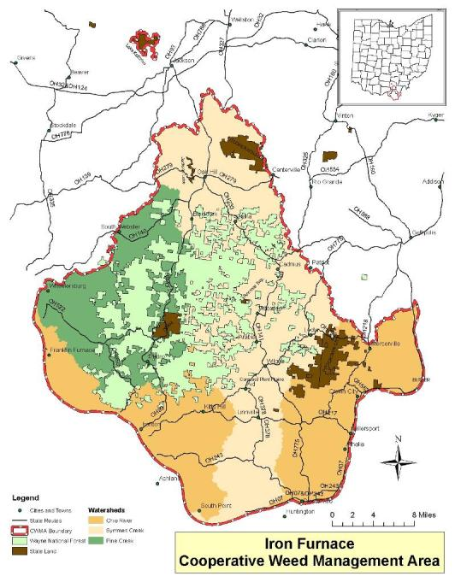
Iron Furnace CWMA
Southern Ohio: Lawrence county and parts of Scioto, Jackson and Gallia counties
Includes:
Wayne National Forest, Ironton District
Dean State Forest
Cooper Hollow Wildlife Management Area
Crown City Wildlife Management Area
Lake Katherine State Nature Preserve
And a lot of private land

Slide 31
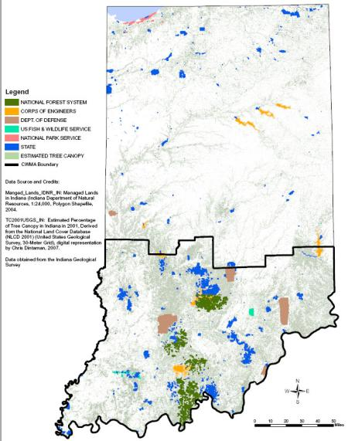
Southern Indiana CWMA

Slide 32
Organizing a CWMA
Identify potential partners and begin building support
Participation from each major land management entity within the boundaries of the CWMA is critical
Involve the following entities if they are available in your CWMA area:
County Weed Supervisors
Resource Conservation and Development Councils (RC&Ds)
Soil & Water Conservation Districts (SWCDs)
Convey the importance to potential partners of using cooperative efforts to address shared problems

Slide 33
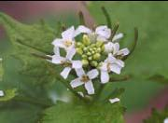
Organizing a CWMA
Determine common goals
Different individuals or groups
in your area may have different
reasons for concerns about
invasive plants
A CWMA may form around the common desire to control:
a specific species such as garlic mustard
a group of invaders such as woody invaders of forests
a common concern such as early detection of new invaders
Find at least one common concern and focus on it to initiate a CWMA.

Slide 34
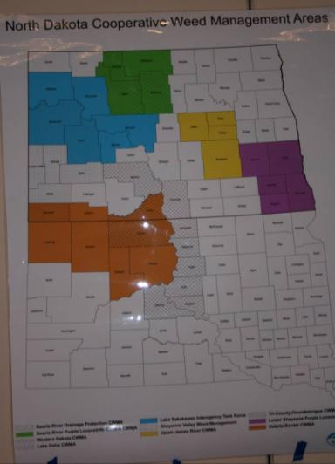
Organizing a CWMA
Select a name
- Geography:
Southern Indiana CWMA
Ramsey County CWMA
Iron Furnace CWMA
Northwoods CWMA
Hawkeye CWMA

Slide 35
Organizing a CWMA
Select a name
- Focus:
Cooperative Weed Management Area (CWMA)
Cooperative Invasive Species Management Area (CISMA)
Partnership for Regional Invasive Species Mgmt (PRISM)
Invasive Plant Partnership/Program/Team

Slide 36
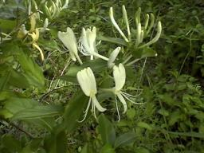
Organizing a CWMA
6. Choose a CWMA fiscal manager
Need to establish fiscal capabilities
to receive grants
Need a federal tax ID number
Possibly enlist a county or a Resource Conservation and Development Council (RC&D) as the fiscal manager

Slide 37
Organizing a CWMA
7. Hold a public meeting
Invite all partners
Invite all major landowners and stakeholders within
your established boundaries
Increase participation and support for your CWMA
A successful CWMA includes many agencies and individuals all working towards a common goal.

Slide 38
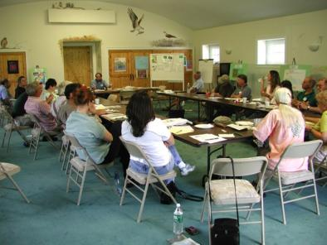
Organizing a CWMA
8. Establish a steering committee
Sets priorities
Provides direction
Establishes operating procedures
Locates opportunities
Furthers the common goals
of the CWMA

Slide 39
Organizing a CWMA
9. Select officers
Ensure that all committee members have opportunities to participate
Delegate responsibility for project accountability
Should be in position for a minimum of two years
The selection of officers for the CWMA should not be as important as overall steering committee activity. The goal is to move from leadership by one person to leadership by the entire steering committee.

Slide 40
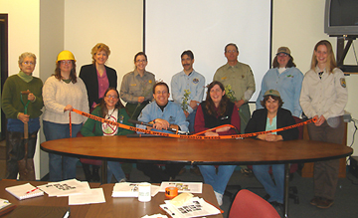
Organizing a CWMA
10. Develop an agreement (MOU or MOA)
Identify the partners and their responsibilities
Establish the legal authorities under which the agreement is made
Define the purpose
List items of agreement and responsibilities of each partner
Describe land area covered under the agreement
The Northwoods CWMA Steering Committee after signing their Memorandum of Understanding (MOU).

Slide 41
Organizing a CWMA
10. Develop an agreement (continued)
The purpose of an agreement is to facilitate cooperation across jurisdictional boundaries and eliminate administrative barriers.
Items of agreement should also specify organizational components including:
The group of partners
Steering committee (size and
structure)
Strategic plan
Annual operating plan
Reports

Slide 42
Organizing a CWMA
10. Develop an agreement (continued)
Develop Hold Harmless Agreement
Forms for landowners or agencies to sign to allow others to come on to their property to do control work
Workers, partners and landowners are “held harmless”
in case of any problems arising
Allows sharing of workers, equipment, supplies

Slide 43
Organizing a CWMA
11. Develop a strategic management plan
Clearly define CWMA objectives and priorities in a plan, including:
An accurate map of the CWMA
An inventory and a map of known priority invasive
plant infestations
Determine management responsibilities including the establishment of management areas or zones
Establish criteria for prioritization of invasive plant management activities
Identify control techniques and resources available to your CWMA

Slide 44
Organizing a CWMA
12. Develop an annual operating plan
Annual projects
Expected in-kind contributions
Necessary funding
Personnel needed
Serves as basis for outside
grant requests
Identifies annual priorities and associated work projects.

Slide 45
Organizing a CWMA
13. Establish and utilize committees
Increase participation by partners and citizens
that are not on the steering committee
Broaden the base of ownership inside the
community
Perform tasks that will give more time for the
steering committee to devote toward coordination
and administrative duties.

Slide 46
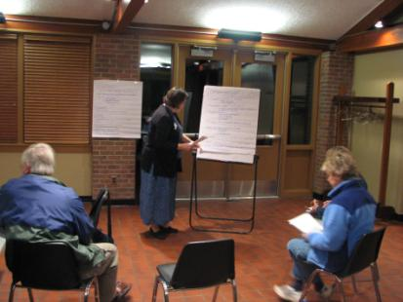
Organizing a CWMA
13. Establish and utilize committees (continued)
Standing committees:
- Long term
- Work on issues like education,
control, monitoring, etc.
Ad hoc committees:
- Temporary
- Focus on specific projects

Slide 47
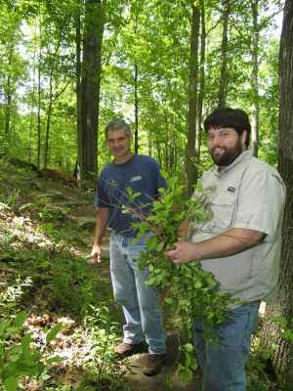
Organizing a CWMA
14. Consider hiring a CWMA Coordinator.

Slide 48
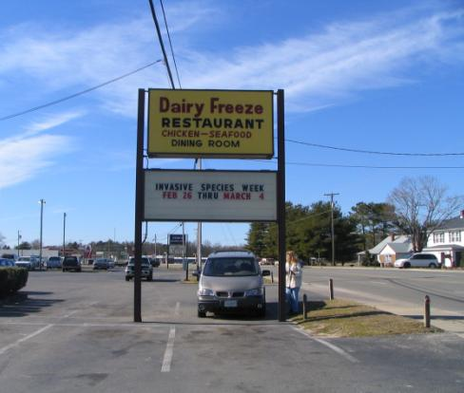
Organizing a CWMA
15. Implement plans
Education
Support and promote
Invasive Species Awareness
events at the federal, state,
and local levels

Slide 49
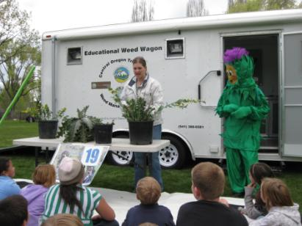
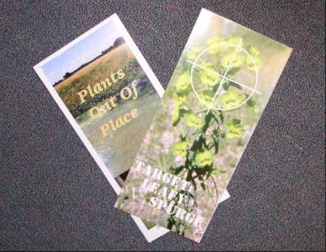
Organizing a CWMA
Examples of Education Projects:
Teach a weed identification class for land owners and land managers
Develop educational materials on invasive species
Create posters or calendars

Slide 50
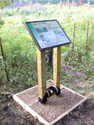
Organizing a CWMA
15. Implement plans (continued)
Prevention
Boot brush stations – placed at entry points to natural areas
Invasive plant trade-in program
Prevention management zones (implement BMPs, e.g. equipment washing)

Slide 51
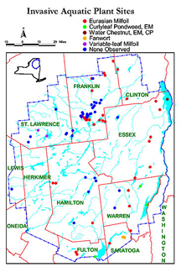
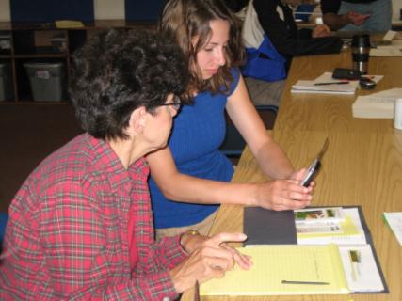
Organizing a CWMA
15. Implement plans (cont.)
Early Detection
Weed Watchers Training
Rapid Responders Team
Adirondack Park Invasive Plant Program

Slide 52
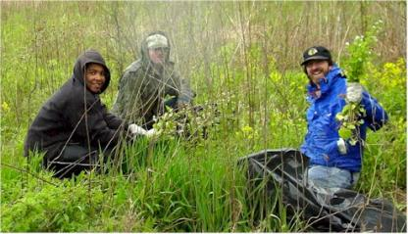
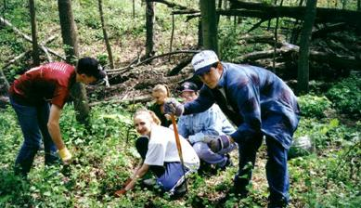
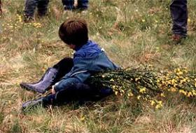
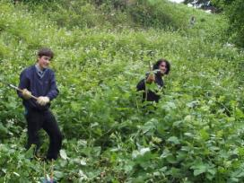
Organizing a CWMA
15. Implement plans (continued)
Control Efforts
Volunteer invasive plant control day
Invasive species control crew

Slide 53
Organizing a CWMA
15. Implement plans (continued)
Monitoring
Monitoring your group’s actions and their
results is important in order to make sure
you are meeting your objectives.
Make sure that any project has a monitoring
component so you can show how you have
successfully accomplished your goals to your
partners, donors, and grantors.

Slide 54
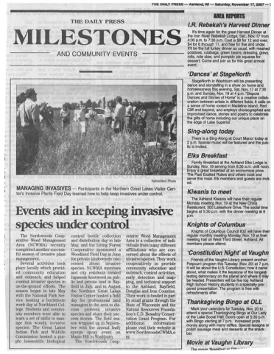
Organizing a CWMA
16. Celebrate success and get media attention
Utilize media and newsletters to broadcast accomplishments
Hold an annual meeting of partners, participants, volunteers, and interested members of the public
Prepare and distribute an annual report
Give awards to key partners, volunteers, and elected officials

Slide 55
Summary
CWMAs facilitate cooperation and empower local citizens.
CWMAs harness creativity and bring new energy to invasive plant management efforts.
A CWMA can benefit any community – it heightens awareness, increases knowledge, and strengthens relationships.

Slide 56
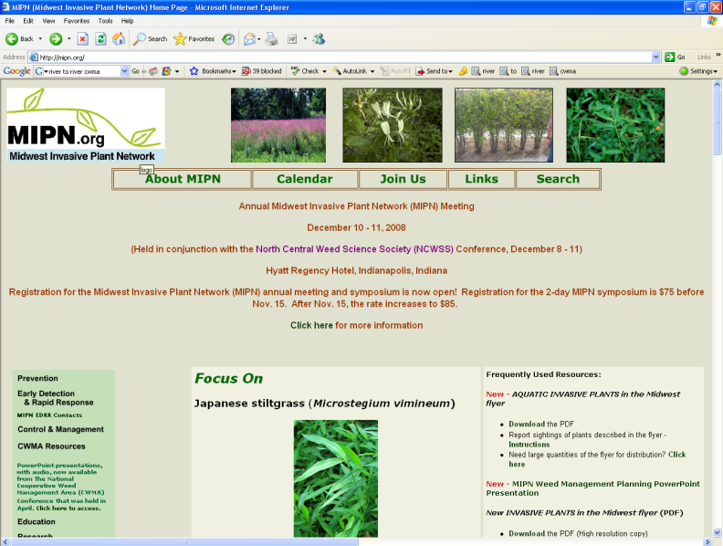
CWMA Resources on the MIPN website (www.mipn.org)

Slide 57
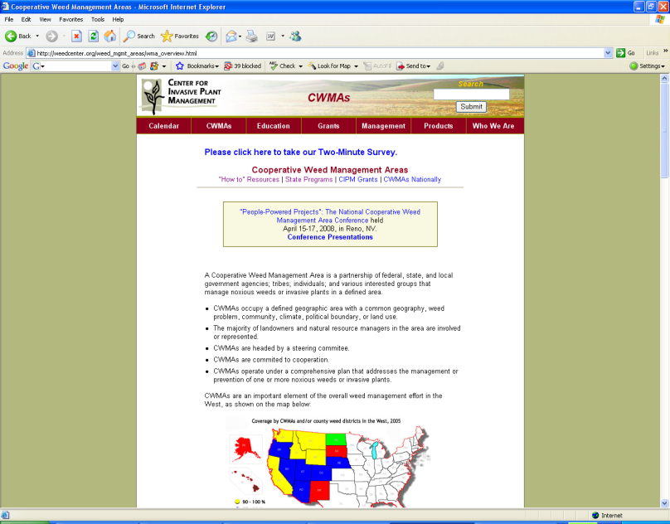
Center for Invasive Plant Management www.weedcenter.org

